Slide 1
Bird Song Identification

Slide 2
BirdNET-Analyzer
BirdNET-Analyzer was developed by Cornell University in the Cornell Lab of Ornithology
Uses Machine Learning to process bird song audio files for bird identification
Pretrained on over 6000 bird species
More training can be done to increase included species
Or can be ran to identify the species
https://birdnet.cornell.edu/
https://github.com/kahst/BirdNET-Analyzer

Slide 3
BirdNET-Analyzer
Has been integrated into many projects
HaikuBox is a device you can buy that listens, records bird songs, and identifies the birds using BirdNET’s model
https://haikubox.com/shop
BirdNET-Pi is a version of the Raspbian OS for Raspberry PI that runs BirdNET’s machine learning model
Can be used to build your own bird ID Raspberry Pi box, built into BirdWeather
https://github.com/mcguirepr89/BirdNET-Pi
BirdWeather is a visualization map of birds BirdNET-Pi are identifying, around the world
https://app.birdweather.com/

Slide 4
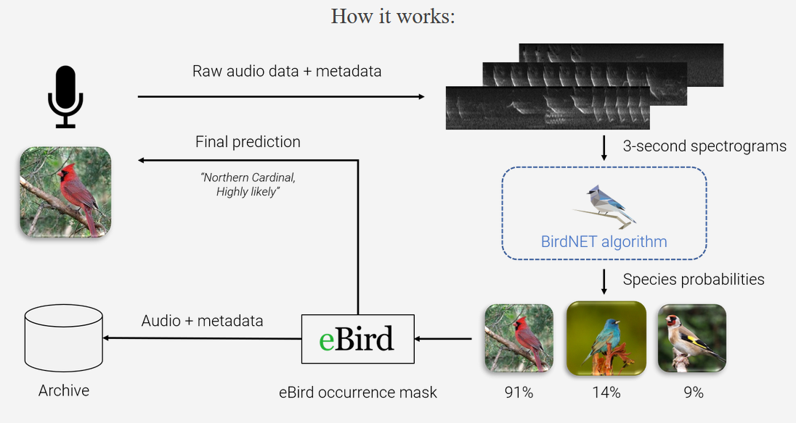
How it works

Slide 5
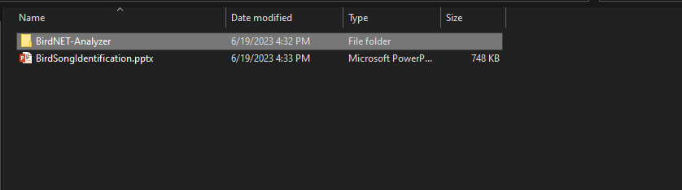
Open BirdNET-Analyzer
On the Desktop, open up the “BirdID” folder
Inside the “BirdID” folder, open the “BirdNET-Analyzer” folder

Slide 6
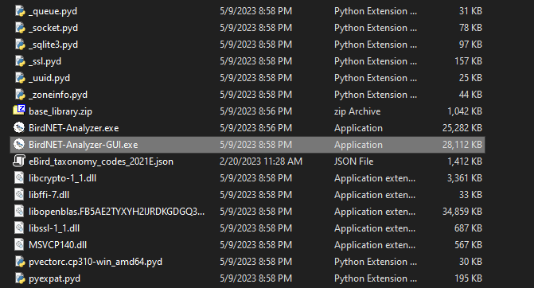
Open BirdNET-Analyzer
In the “BirdNET-Analyzer” folder, scroll down until you find the “BirdNET-Analyzer-GUI.exe” file, then double click it

Slide 7
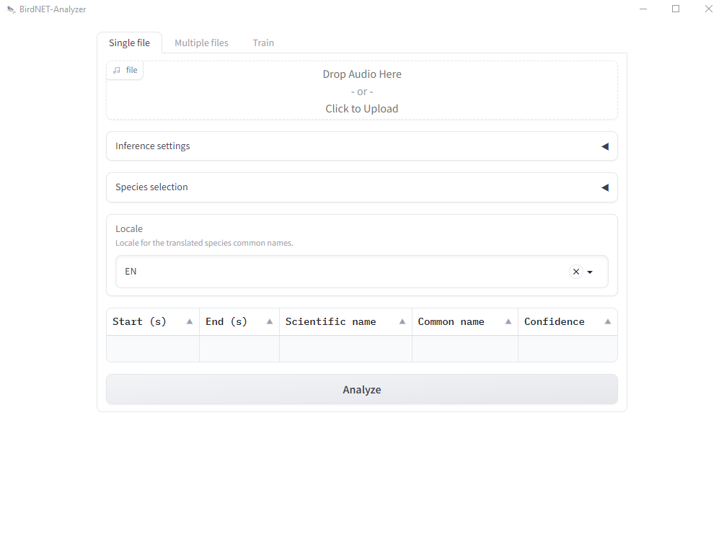
Open BirdNET-Analyzer

Slide 8
Open BirdNET-Analyzer
To analyze your Bird Song Audio files, click the file upload button

Slide 9
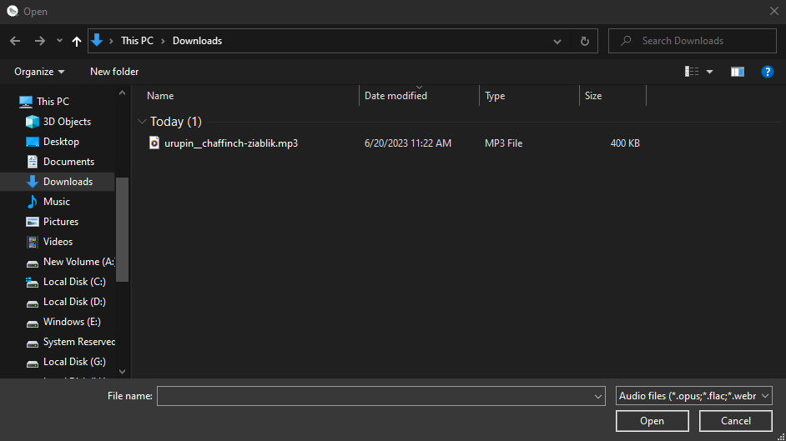
Load Files
Select the file you want to analyze and then click “Open”

Slide 10
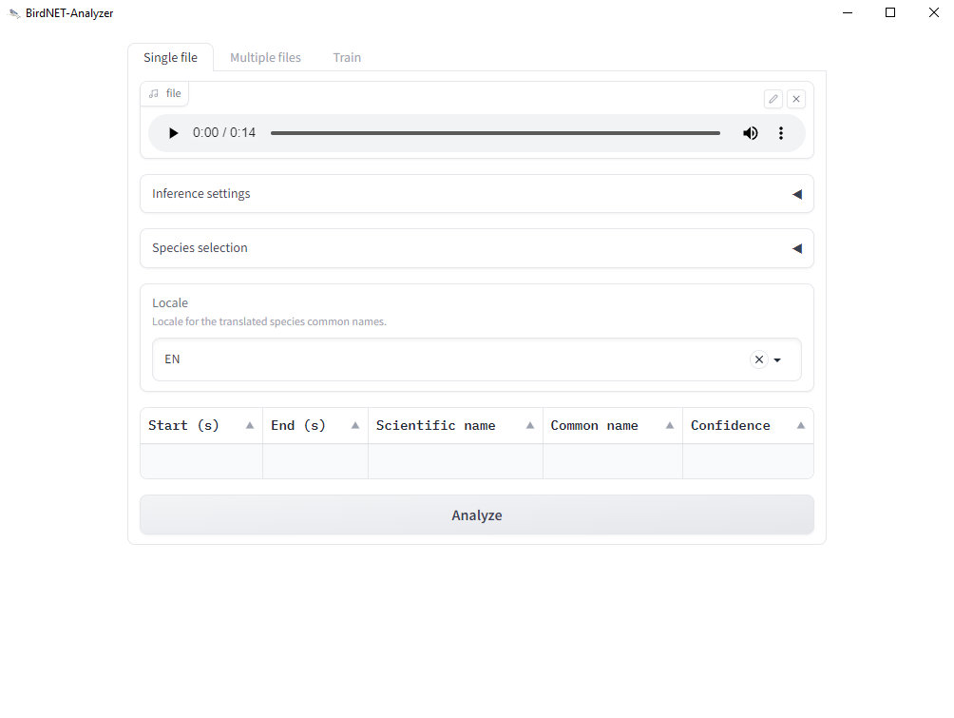
Load Files
With the audio file loaded, click the “Analyze” button

Slide 11
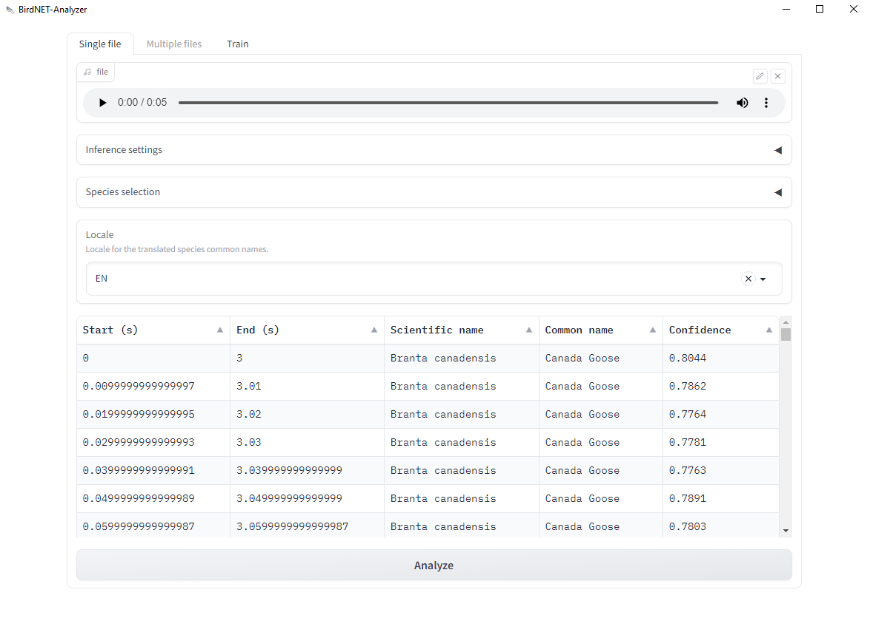
Analyze File
Once the program is done analyzing, the output should look similar to below

Slide 12
Analyze Files
Go through the remaining files you recorded
Write down and record the output of each file
If you knew what species your were recording, is the analyzer correct?

